Slide 1
Logistic Regression
by
Dr Lalit Prasad

Slide 2
outline
What is logistic Regression?
Why Logistic Regression Equation
How it works ?
A Case Study : Logistic Regression

Slide 3
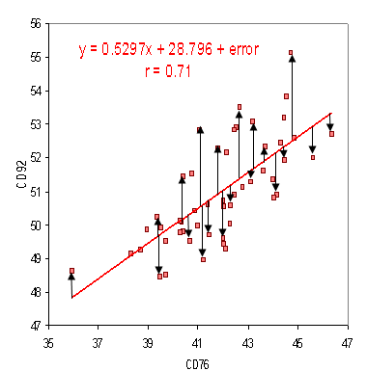
What is Regression?
Regression analysis is a predictive modeling technique.
It estimates the relationship between a dependent (target) and an independent variable(Predictor).
Regression Equation: Y = 0.5297X+28.796, for any value of X , we can predict the value of Y.

Slide 4
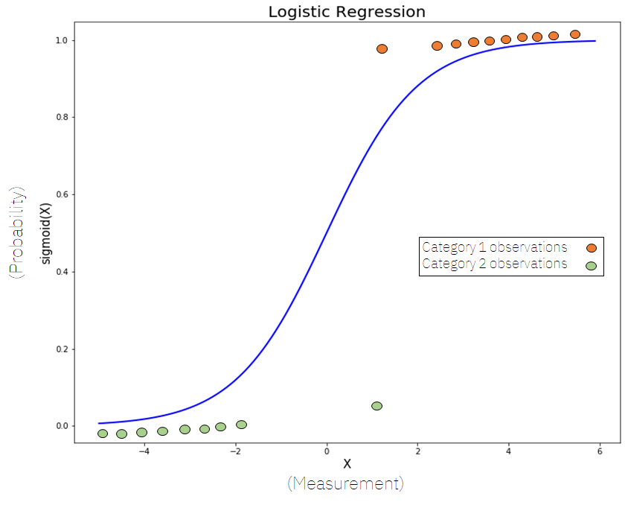
Why Logistic Regression?
Whenever the outcome of the dependent variable (Y) is discrete like 0 or 1, Yes or No, A, B, C, we use logistic regression.

Slide 5
Why can’t we use linear regression?
Since, our value of Y will be between 0 and 1 in logistic regression but in linear regression it may cross 0 or 1, so, the linear line has to be clipped at 0 and 1. With this our resulting curve cannot be formulated into a single formula. So we needed a new way to solve this kind of problem.. Hence logistic regression is required.

Slide 6
Why not Linear
1
0

Slide 7
Why not Linear
1
0

Slide 8
Linear Regression Vs Logistic Regression
Linear Regression
DV=Continuous Variable
Solves Regression Problem
Straight Line
Logistic Regression
DV= Categorical Variable
Solves Classification Problem
S Curve

Slide 9
Logistic Regression
Threshold value indicates the probability of winning or losing
1
0.8
0.6
0.4
0.2
Threshold Value
0

Slide 10
Logistic Equation
Equation for a straight line: Y= β0+β1X1+β2X2+………..………. , Range of Y is from -∞ to + ∞
Lets try to find the logistic regression from the above equation.
Y = β0+β1X1+β2X2+………..………….
In logistic equation Y can be only between 0 and 1.
Now, to get the range of Y between 0 to + ∞, lets transform Y Y Y= 0 ] 0
1-Y Y = 1] ∞

Slide 11
Let us transform it further, to get the range between - ∞ to ∞
Y
Ln , Y = β0+β1X1+β2X2+………..
1-Y
Logistic Regression Equation:
Y e ^{β0+β1X1+β2X2 +………}
Logit (Y) = Ln , P(Y) =
1-Y 1+ e ^{β0+β1X1+β2X2 +………..}

Slide 12

Logit Model or Log odds ratio or Logit
e ^{β0+β1X1+β2X2 +…………….}
P(Y) =
1+ e ^{β0+β1X1+β2X2 +………..}
P (Y) $=\frac{1}{1+e^{−(βo+β1X1+β2X2+ ……..)}}$

Slide 13
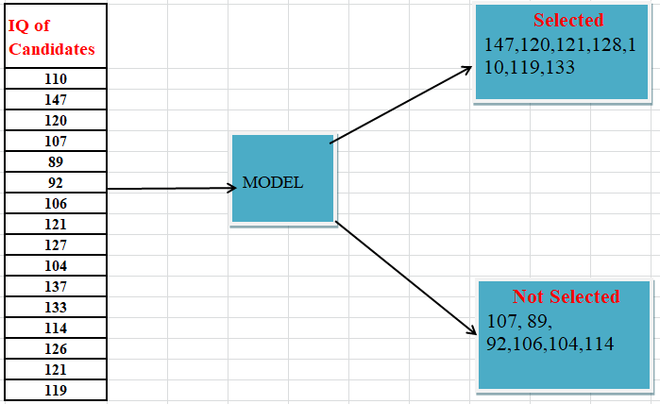
How does logistic regression work?

Slide 14
Assumptions of Logistic Regression
Dependent variable should be measured on a dichotomous scale
One or more independent variable which can be either continuous or categorical or mixed
Independence of observation and should have mutually exclusive and exhaustive categories

Slide 15
Topic:1
Prediction Model for selection of candidate using logistic regression

Slide 16
objectives
To find the data of independent and dependent variables.
To develop a model to predict the selection of a candidate.

Slide 17
DATA and DATA Analysis

Slide 18
-2 log likelihood
Log likelihood is based on the summing the probabilities associated with the predicted and actual outcomes
It is analogues to the residual sum of squares in multiple regression in the sense that is an indicator of how much unexplained information there is after the model has been fitted.
Large value of the log likelihood statistics indicates poorly fitting statistical models because the larger the value of the log likelihood the more unexplained observation.

Slide 19
Pseudo R-SQUARE
Cox and Snell R-square
Nagelkerke R-square
Mc Fadden R-square (multinomial)

Slide 20
Cox and Snell’s R-square
It is based on the log likelihood for the model compared to the log likelihood for the baseline model
However with the categorical outcomes it has a theoretical maximum of less than 1 even if for the perfect model.

Slide 21
Nagelkerke’s R-square
It is adjusted version of the Cox and Snell’ s R- Square that adjust the scale of the statistics to cover the full range from 0 to 1.

Slide 22
Model Summary
Cox & Snell’s R Square and Nagelkerke’s R Square are the methods of the calculating the explained variation. These are sometimes referred as pseudo R-square value. The explained variation in the dependent variable based on our model range.

Slide 23
Topic:2
Patient’s diabetes prediction using logistic regression

Slide 24
objectives
To find the data of independent and dependent variables.
To develop a model to predict a patient is diabetic or not.

Slide 25
Independent variables and Dependent variable
Independent variables
Npreg= number of pregnancies
Glu= plasma glucose concentration
BP=Blood Pressure
Skin: Triceps skin fold thickness
BMI=body mass index
Ped =diabetes pedigree function
Age = Age in Years
Dependent Variable
Diabetes :
Yes -1
No-0

Slide 26
Thank You

